Slide 1



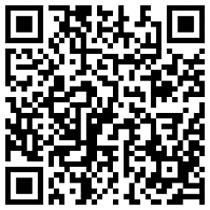
2023-24 Dual Credit Meeting
Abrams: Abrams, Housson, Flakes, Lucas
Cash: Brooks, Hamel, Jackson, Stribling
Marks: College Academy 9th and 10th grade
Dual Credit
Resources:

Slide 2
What is Dual Credit?
What
Is
Dual
Credit
An opportunity for High School students to be “dually enrolled” and earn credit for both a high school course and a college course at the same time.
    On the high school campus, taught by a CRHS teacher who is a Lone Star College qualified teacher.
    Cy-Fair ISD has an agreement with Lone Star College- Cy-Fair to offer courses for college credit at Cypress Ranch
    Students who enroll in a dual credit course at Cypress Ranch will build a transcript with Lone Star College and Cypress Ranch at the same time

Slide 3
Opportunities to earn College Credit in HS
Dual Credit (DC) Advanced Placement (AP)
Dual Credit | Advanced Placement -AP
Enrolled in Lone Star College and Cy-Ranch HS course | Enrolled in campus AP course
Pay tuition (currently $78 per course). Payment due each semester, except year-long courses | Pay for AP exam ($101)
Grade in course throughout semester determines credit | Score on AP test in May determines credit
LSC credit transfers to public Texas universities and numerous universities outside of Texas within U.S. | University determines test score requirements. Qualifying test scores are nationally accepted.

Slide 4
Common Myths Regarding Dual Credit
It’s Easy!
It’s too HARD!
Dual Credit ONLY transfers to in-state, public colleges/universities!
If I am taking the AP Test, Dual Credit will not benefit me.
If I am taking Dual Credit, the AP Test will not benefit me.
Maximize College Credit: You can take BOTH the AP Test and Dual Credit!

Slide 5
What you should know about the Dual Credit Class...
Not merely a “high school” course - this is COLLEGE!
Challenging college course work should be expected! However, teachers will work to improve necessary skills if the student is willing to do the work.
There are not many grades… ALL assignments count! No late work accepted!
You are enrolling as a Lone Star College student… YOU now have a college transcript!

Slide 6
What you should know about the Dual Credit Class...
You must qualify with test scores!
You must pass the course with a C or better (70+) to remain a Dual Credit student and for the credit to transfer.
Your grade in the Dual Credit course could be a factor in your College Admissions as well as Financial Aid Awards

Slide 7

Financial Benefits...
College/University | 3 hours | 6 hours | 9 hours
Dual Credit – Lone Star College | $78 | $156 | $234
UT Austin | $2514 | $3710 | $4563
Texas A&M | $1646 | $2973 | $5185
Sam Houston | $1326 | $2377 | $3428
UH | $1261 | $2523 | $3785
Lone Star College (On Campus) | $288 | $576 | $864
College Credit earned in HS can save your family MONEY!
Adopted and foster children get all fees waived. Speak with DC Counselor
Free/Reduced lunch students may qualify for a partial DC scholarship; see DC Counselor during registration
Payment due at the beginning of EACH semester, unless it is a year-long course.
College Credit Only 3-hour course at LSC = $288 (+ books & fees)

Slide 8
Which DC courses are offered at Ranch?
CFISD Course | LSC Fall Course | LSC Spring Course
Art History AP | ARTS 1303 | ARTS 1304
Biology II AP | BIO 1406 | BIO 1407
Calculus AB AP | MATH 2413 (year long) | MATH 2413
Calculus BC AP | MATH 2413 | MATH 2414
AP Physics I (tentative) | PHYS 1401 (year long) | PHYS 1401
Chemistry AP | CHEM 1411 | CHEM 1412
College Algebra K | MATH 1314 (year long) | MATH 1314
Communication | SPCH 1311 (semester only) | SPCH 1311
Economics | ECON 2301(semester only) | ECON 2301
English III K | ENGL 1301 | ENGL 1302
English IV K | ENGL 1301 | ENGL 1302
English IV AP (must have taken Eng 3 DC) | ENGL 2322 | ENGL 2323
Government AP (US Gov’t) | GOVT 2305 (semester only) | GOVT 2305
Pre-Calculus K | MATH 1316 | MATH 2412
Psychology | PSYC 2301 (semester only) | PSYC 2301
*SPTSS AP (Texas Government) | *must have earned 2305* | GOVT 2306 (semester only)
US History AP | HIST 1301 | HIST 1302
* Student must have taken GOVT 2305

Slide 9
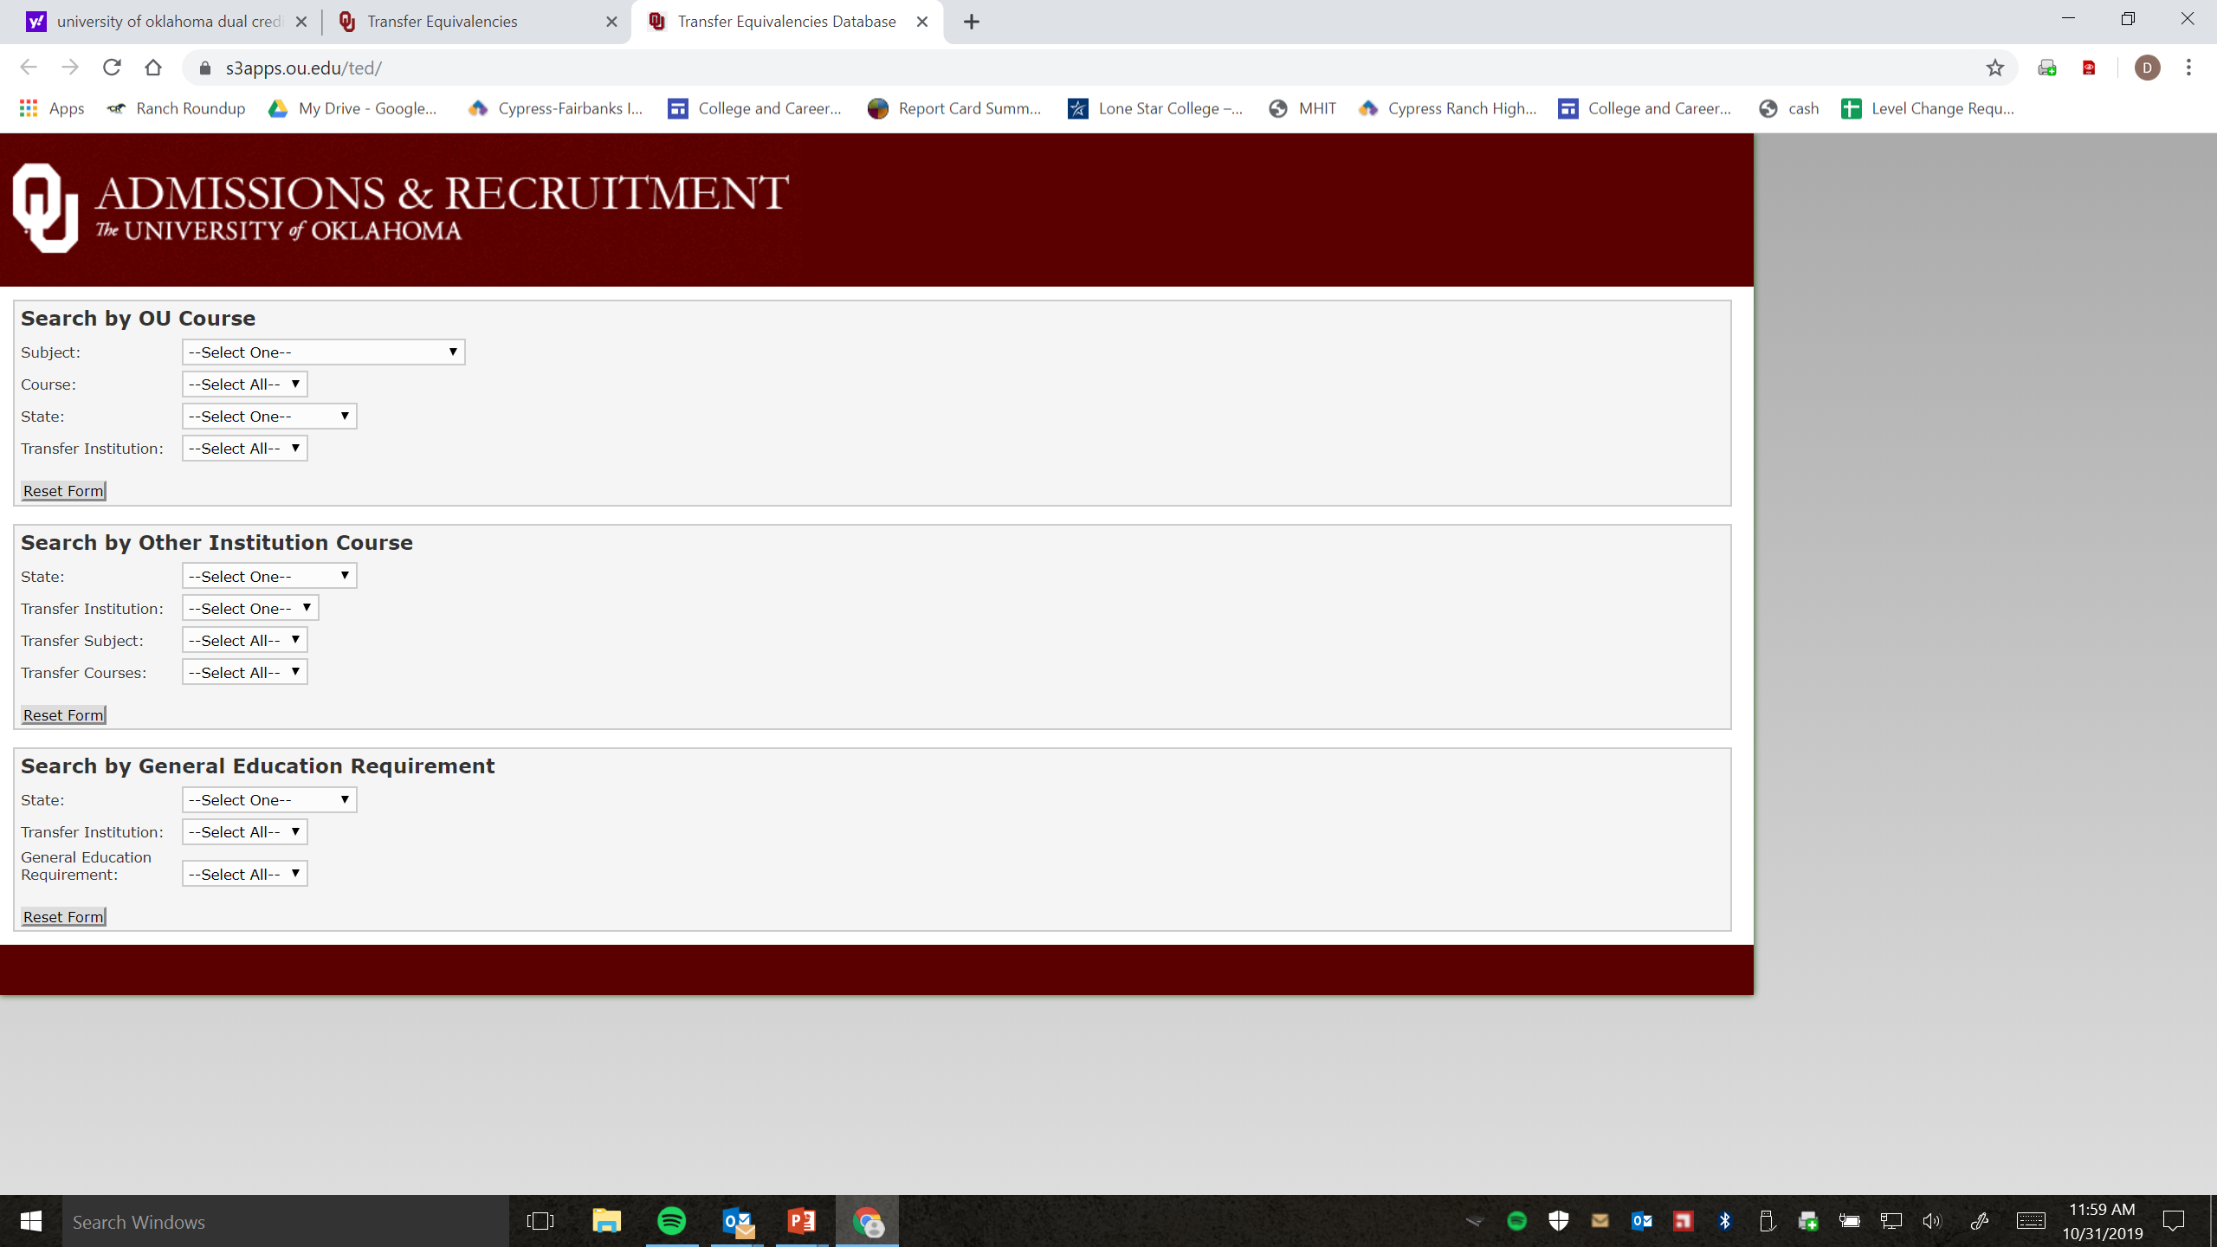
Transfer of credits
College courses usually transfer as one of three types of credits:
    Elective Credits
    General Education Credits
    Major Field of Study Credits
**Check with the university’s Transfer Equivalency Database**
Research degree plans at colleges you’re interested in
before signing up for courses!

Slide 10
Dropping a DC Course
Student must meet with DC Counselor and complete a LSC drop form.
There is a date to drop with a “W” on college transcript (Fall 2023 date is November 13th), and there is a date to drop without a “W” on college transcript (Fall 2023 date is September 11th)
Does not count towards 6 drop rule, but it can impact a student’s satisfactory academic progress which may impact financial aid
If students drop with a “W”, they will have to appeal with LSC if they want their AP scores to earn DC credit
Students dropping a DC course move to an equivalent course thru the rest of the year.
*Students cannot transfer DC courses
to another HS during the DC course*

Slide 11
How do I register for
Dual Credit?

Slide 12

STEP #1
Obtain a Lone Star ID #:
Use the GOLD handout to create an account
Lone Star College will email you your LSC ID# (7 digits) within 48 hours after completing these steps
College Academy students already completed this step and have a Lone Star ID #

Slide 13
STEP #2
Are you college ready?
What are the testing requirements?
Test requirements are set by the state to prove college readiness through a variety of testing options.
Students MUST meet test requirements before they will be allowed to register!
If the student does not qualify with test scores, they must take and pass the TSI test (higher math and science courses also require the Accuplacer test).
See handout for specific testing requirements

Slide 14

STEP #3
Bring the following information to your Dual Credit Counselor:
Your 7-digit Lone Star College ID#
Qualifying test scores

Slide 15
TSIA2 Test Facts
Students must have met with their DC Counselor prior to testing.
TSIA2 is offered at CRHS for FIRST TIME TESTERS ONLY on the following days:
February 17: Must register with DC Counselor
February 23 and 24: College Academy Students only
TSIA2 test is also available at the LSC campus in the testing center on the computer. Saturday testing is available.
Testers must make an appointment in order to test. No walk-ins.
The TSIA2 can also be taken remotely through a 3rd party proctor (not recommended). A system check will determine if your PC is compatible. Chromebooks issued by CFISD is not compatible with the test.
Review sessions for the TSI are available at Lone Star on the following dates:
  February 15th, 18th, 22nd
  March 1st, 8th, 22nd, 29th
  April 5th, 12th, 15th, 19th, 26th
  ***NOTE***
  At least TWO DAYS BEFORE testing, students MUST complete the
  Pre-Assessment Activity.
  Students will be sent home without testing if this is not completed.

Slide 16

TSIA2 Assessment Tips
The test is not timed. The time varies depending on how you answer.
If you can not answer a question, eliminate as many answers as possible and guess; there is no penalty for incorrect answers.
Solve the question first, then look for your solution in the answer list.
Don’t second-guess yourself!
If you don’t pass, don’t panic! You can retake it as many times as you want.

Slide 17
Test Practice
Online and virtual
review sessions are available.
Information is included
on the back of the
Dual Credit Testing Checklist
Your DC counselor will give you after checking test scores.

Slide 18
Let’s recap... Enrolling in Dual Credit
Step 1: Attend the Dual Credit Presentation.
Step 2: Bring LSC ID # and qualifying scores to your DC Counselor:
Student meets Testing Requirement | Student does NOT meet Testing Requirement
Step 3: Complete the Lone Star College Registration Form with Parent | Step 3: Complete the Pre-Assessment Activity in your LSC portal 2 days before you test!
Step 4: Submit the completed LSC Registration Form to your DC Counselor no later than April 28th | Step 4: Attend review session or visit website for study resources (optional).
Step 5: Make a Payment online between July 26th - August 1st | Step 5: Sign up to test, test, and bring qualifying scores to DC Counselor.
 | Step 6 : Complete the Lone Star College Registration Form with Parent
 | Step 7: Submit the completed LSC Registration Form to your DC Counselor no later than April 28th
 | Step 8: Make a Payment online between July 26th - August 1st

Slide 19
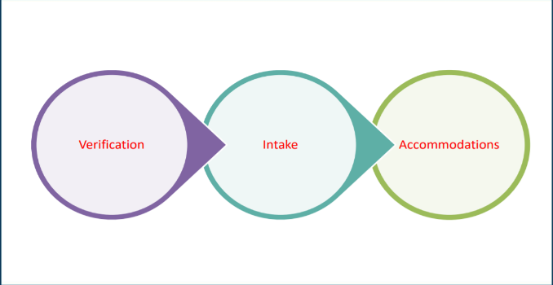
Accommodations
Modifications
If your student receives any accommodations and/or modifications at Cy-Ranch, the student must apply each semester for assistance at the Office of Disabilities at LSC. No accommodations and/or modifications will be given without LSC approval.
Contact LSC Office for Students with Disabilities Office
http://www.lonestar.edu/disability-services.htm
Select “Students Requesting Accommodations” to arrive at the Requesting Accommodations web page:
https://www.lonestar.edu/requesting-accommodations.htm
Stephanie.g.dillon@lonestar.edu
LSC Disability Services Counselor
281-290-3260

Slide 20
Interested in DC Summer School…
Session 1:
June 5 –
July 11
Session 2:
July 13-
August 20
Classes offered 3 ways: in-person, online, and hybrid (some face to face)
AP/Dual Credit GPA Points apply
Student must bring test scores to DC Counselor
Student must satisfy the Bacterial Meningococcal vaccine requirement (upload shot record into LSC portal)
Once students have qualifying test scores and Bac Men shot uploaded, they meet with DC Counselor to complete registration paperwork.
LSC DC Registration Form due for summer 2023 is March 3rd
Students will self-register for courses on reg form on-line in their LSC portal March 28th-30th
Summer dual credit payments due April 15th thru April 30th in your LSC portal

Slide 21

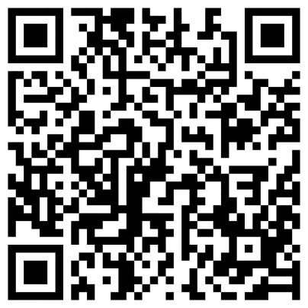
Questions?
If your alpha counselor is Abrams, Housson, Lucas, or Flakes:
please contact Danielle Abrams at Danielle.abrams@cfisd.net
If your alpha counselor is Brooks, Hamel, Stribling, or Jackson:
please contact Dede Cash at Deirdre.cash@cfisd.net
If you are 9th or 10th grade College Academy:
please contact Kimberly Marks at Kimberly.marks@cfisd.net
Dual Credit
Resources:
College Academy students and parents need to stay

Slide 22
Additional Information for College Academy students & their families
College Academy Contacts
College Academy Mentor
Nancy Witmer
Nancy.Witmer@cfisd.net
College and Career Specialist
DC Team Member
Kimberly Marks
Kimberly.Marks@cfisd.net

Slide 23
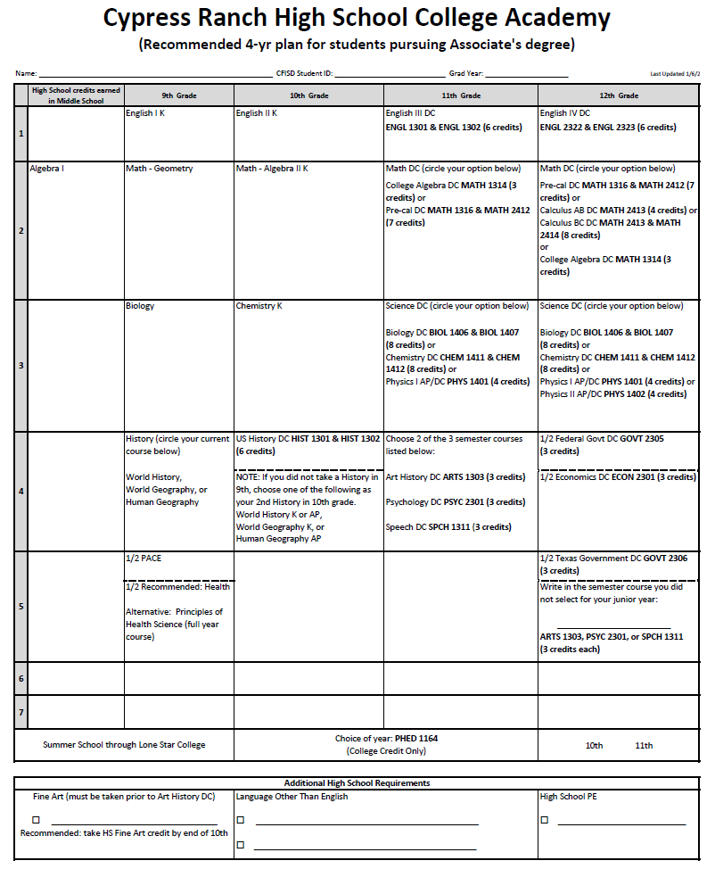
Four-Year C.A. Planning
Worksheet
9th - PACE
10th - US History DC

Slide 24
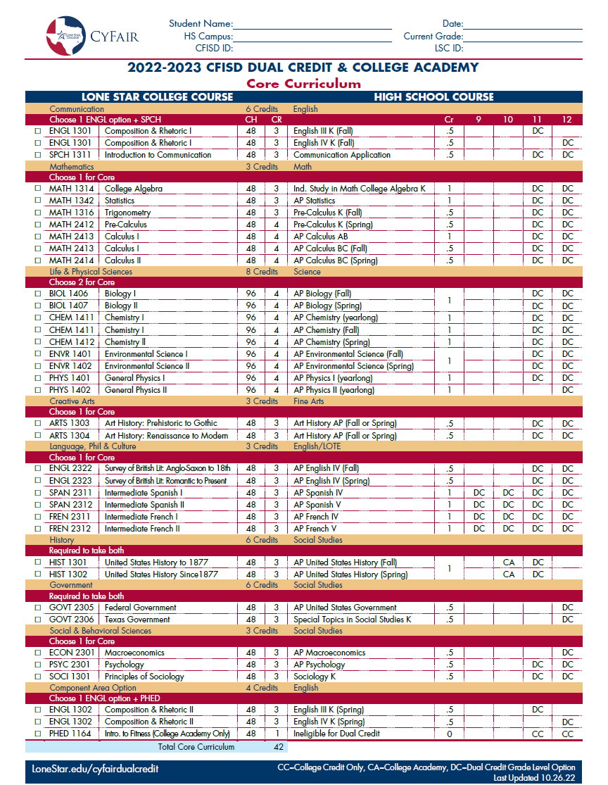
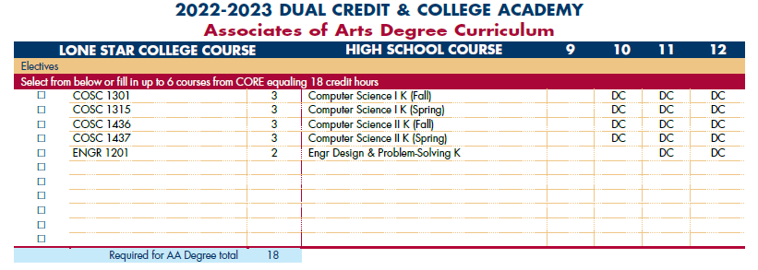
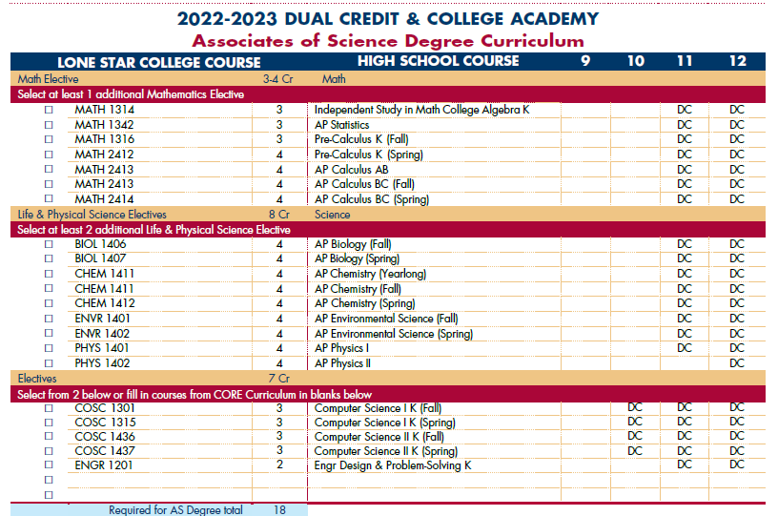
LSC Degree Plans
Core Curriculum
42 credit hours
Associate of Arts
18 credit hours of Electives
Associate of Science
3-4 credit hours Math
8 credit hours Science
6-7 credit hours of Electives

Slide 25
Cost Comparison
DC vs CCO
Dual Credit (DC) courses currently cost $26 per credit hour
  3-hour course = $78 (textbooks and other course fees are covered by CFISD unless taken in the summer)
College Credit Only (CCO) courses currently cost $96 per credit hour for in-district students
  3-hour course = $288 (+ the cost of textbooks & other course fees)
If students switch to the Assoc. of Arts degree, they will need to take CCO electives to earn their remaining elective credits which will each cost nearly 3 times more than a DC course.

Slide 26
Earning the Associate of Science on our campus
10th grade
US History DC*
* 2nd history required if student did not take history in 9th
Summer after 10th or 11th
PHED 1164* COLLEGE CREDIT ONLY course
* Students have successfully completed this course online and in-person
11th grade
DC English
DC Math
DC Science
2 of these 3 semester courses: Art History DC, Speech DC or Psychology DC
12th grade
DC English
DC Math
DC Science
Remaining semester course: Art History DC, Speech DC or Psychology DC
US Govt DC, Texas Govt DC, and Econ DC
NOTE: For Associate of Arts, students will need to take more electives in the summer.

Slide 27
PHED 1164
College Credit Only
This college credit only course must be taken in order to earn an Associate Degree through Lone Star College. In-person and online options are available.
(English college-readiness scores required.)
All LSC summer school registrations must be completed through your dual credit counselor no later than March 3rd.

Slide 28

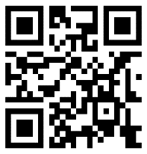
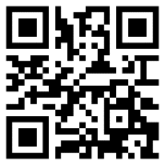

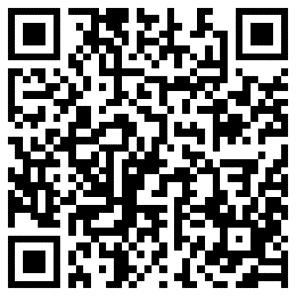
Questions?
Danielle Abrams If your alpha Counselor is:
Danielle.abrams@cfisd.net Abrams, Flakes, Housson, or Lucas
Dede Cash If your alpha Counselor is:
Deirdre.cash@cfisd.net Brooks, Hamel, Jackson, or Stribling
Kimberly Marks If you are 9th or 10th College Academy
Kimberly.marks@cfisd.net
Dual Credit Resources

